Slide 1
Linear Regression
Created by: Mahipal Singh

Slide 2
Part 1: Concept Before Code
What is Linear Regression?
It models the relationship between a dependent variable (target) and one or more independent variables (features) by fitting a straight line.
Mathematical form:
y=β0+β1x+εy
It predicts continuous values, like:
House prices
Temperature
Salary based on experience

Slide 3
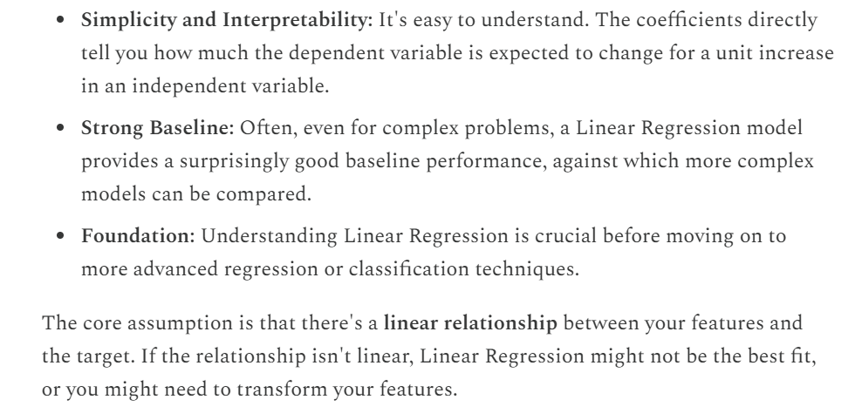
Why do we use it?

Slide 4
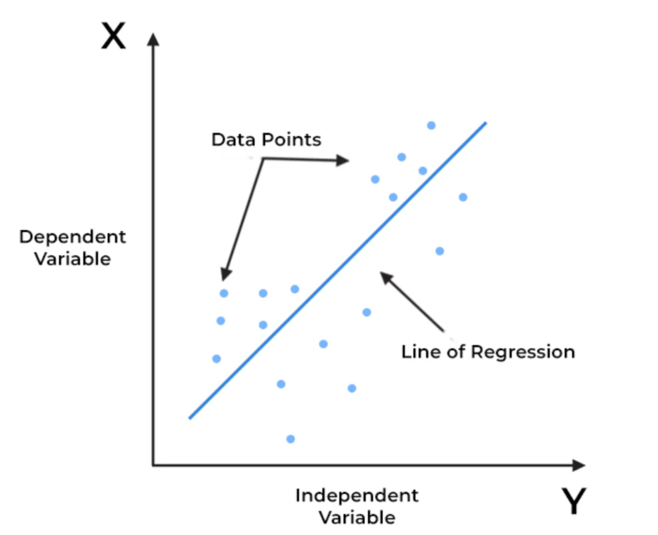

Slide 5

Mean square error
Evaluation metric

Slide 6
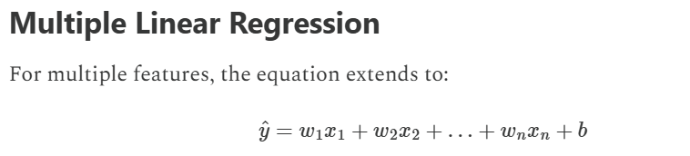

Slide 7
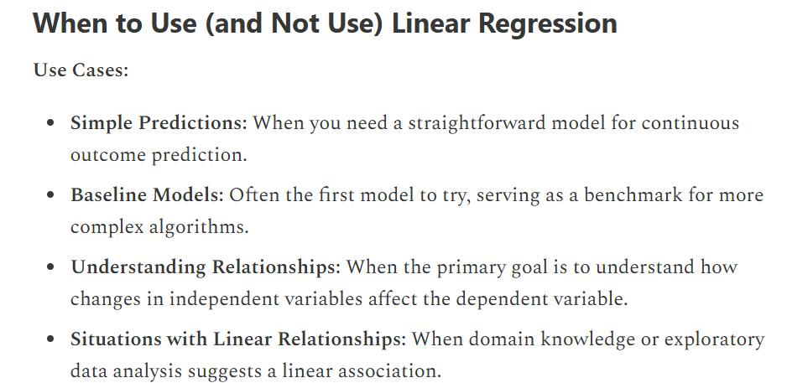

Slide 8
